Slide 1
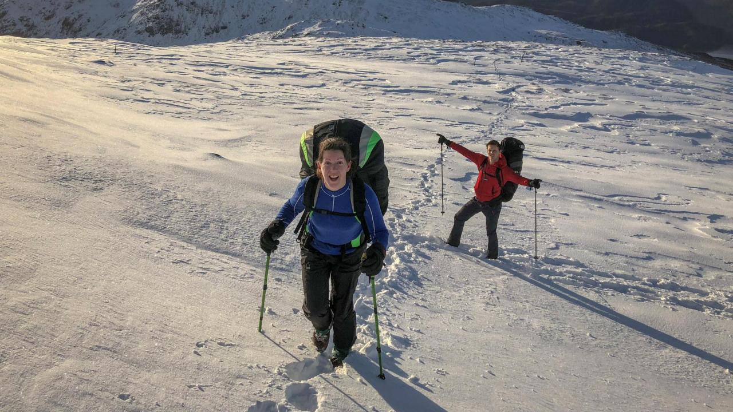
COLD INJURY
Dr Matt Wilkes

Slide 2
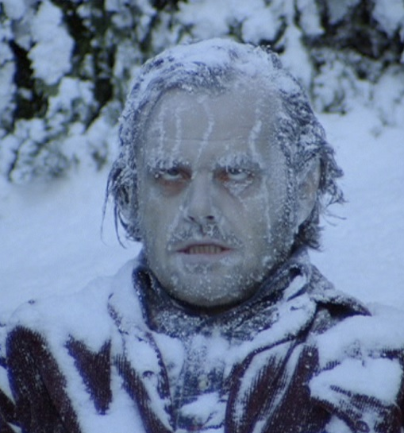
Cold
Heat balance
Getting cold
Hypothermia
Cold injury

Slide 3
Heat production and transport
Muscle activity
Catabolism
Blood

Slide 4
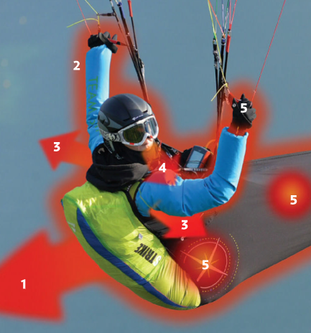
Heat Loss
Convection
Radiation
Evaporation
Respiration
Conduction

Slide 5
Feeling cold

Slide 6
Hypothermia vs. Cold Injury

Slide 8
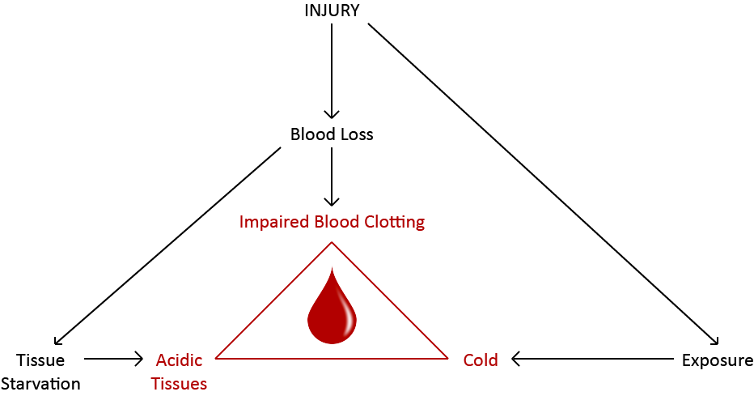
Does it affect us when we crash?
Environmental Protection
Notes:
If we crash when we are cold, it’s bad

Slide 11
Peripheral cold injury

Slide 12
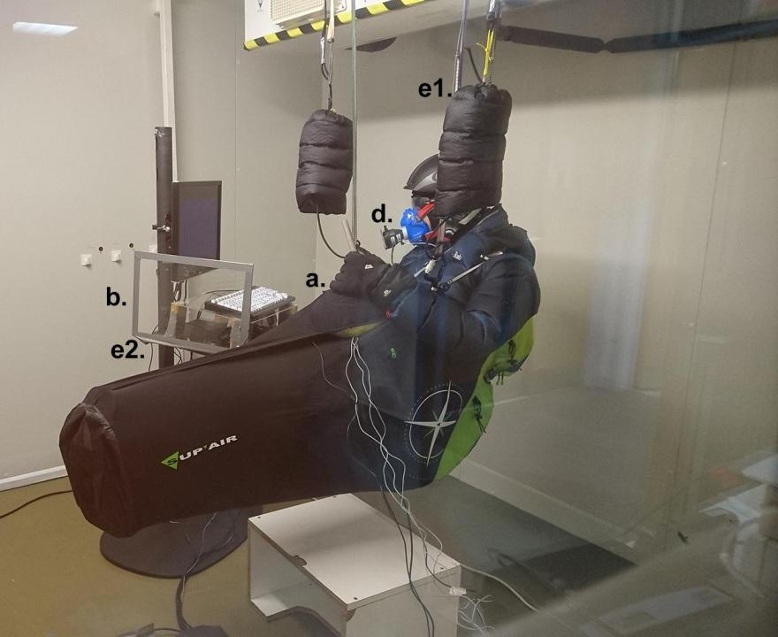
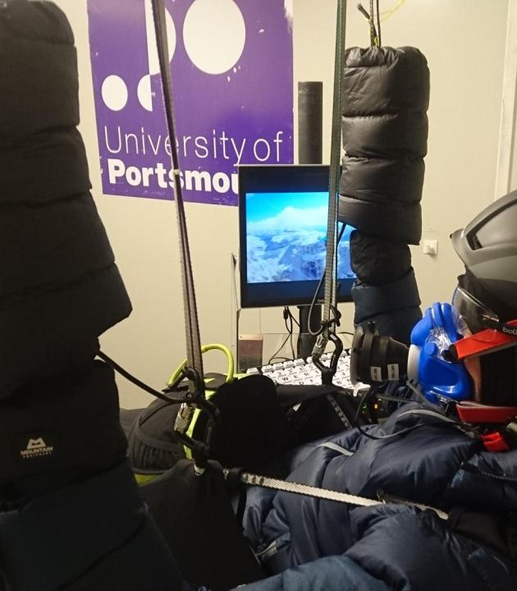

Slide 13
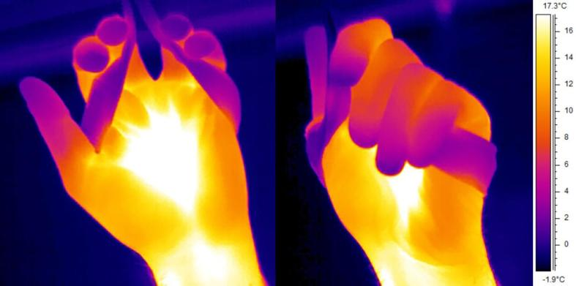
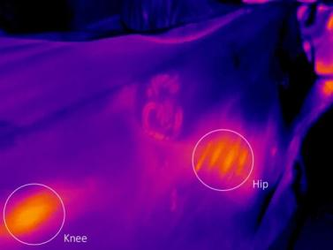

Slide 14
Why is this a problem?

Slide 15
Cognition
Distraction?
Arousal?
Information processing?
Changes in response times?

Slide 16
Holmer et al. 2011

Slide 17
Holmer et al. 2011

Slide 18
Frostbite

Slide 20
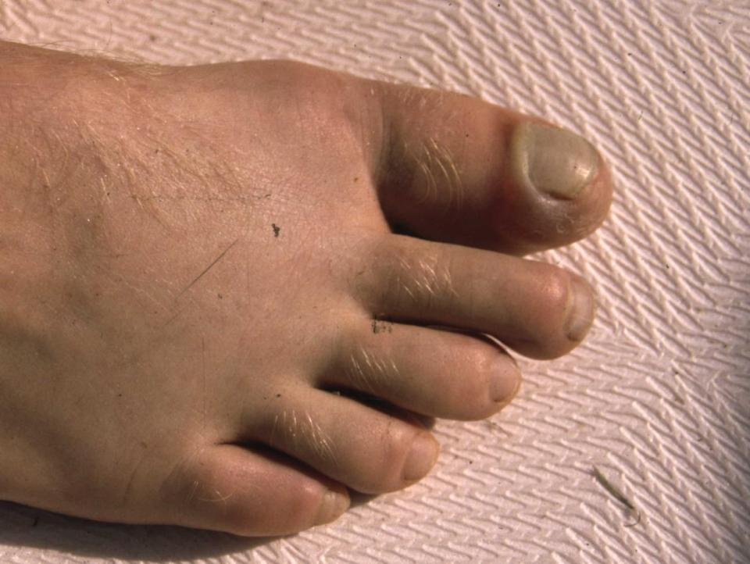

Slide 21
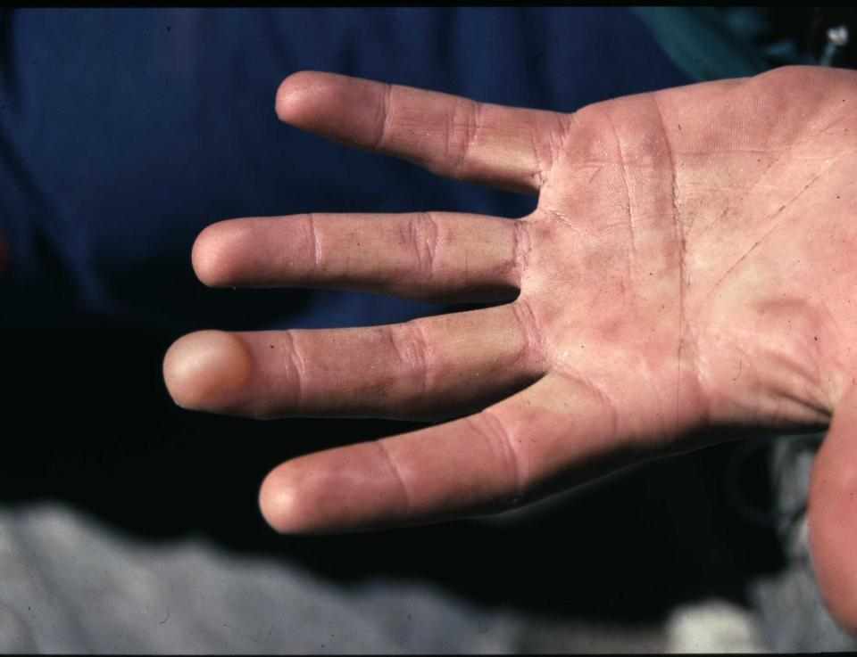

Slide 22
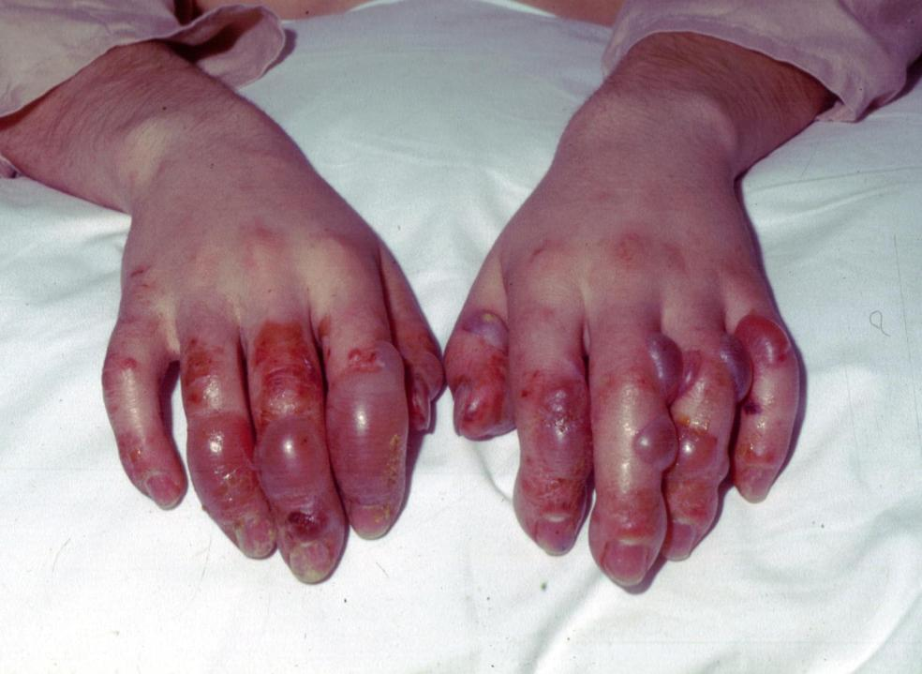

Slide 23
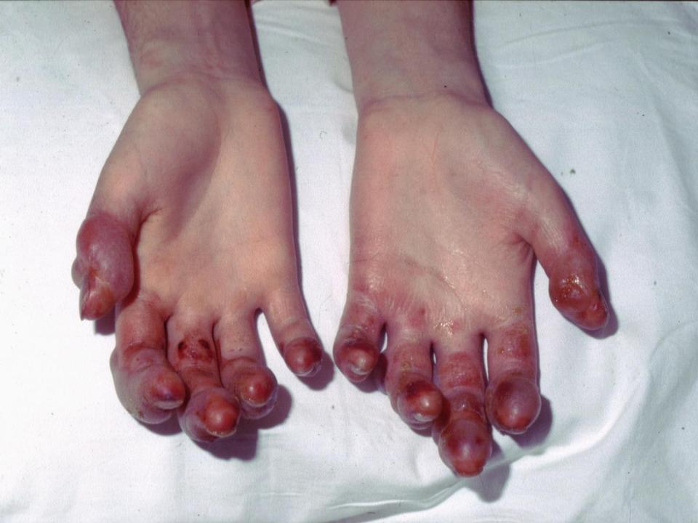

Slide 24
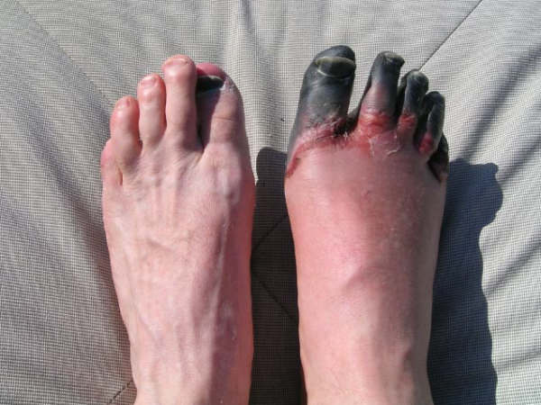

Slide 25
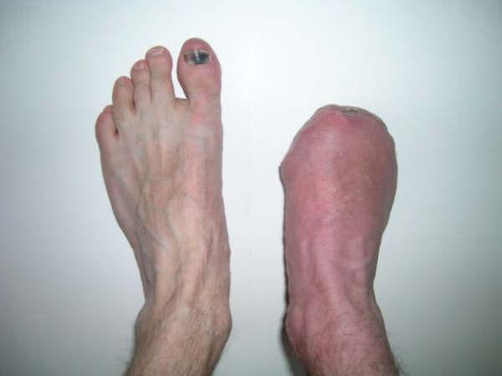

Slide 26
Field treatment 1
Protect frozen tissue from further damage
Remove jewellery
Do not rub or apply ice or snow
Keep frozen rather than thaw-freeze
Treat hypothermia
Adequate hydration
Give ibuprofen or aspirin

Slide 27
Field treatment 2
Dressings – bulky dressings
Elevation – may reduce oedema
Frozen feet – best to avoid weight-bearing minimise trauma if unavoidable
Field rewarming – water at 37-39 degrees, about 30 minutes
Slow rewarming if above unavailable
Do not drain blisters unless likely to burst
Aloe vera (reduces prostaglandin/thromboxane production)
Oxygen

Slide 28
Non-freezing cold injury

Slide 29
Vale et al. 2017

Slide 30
Prevention – maintaining circulation
Gloves
Active warming
Insulate torso, head, armpits, forearms
Boots not too tight
Protected position
Pod
Regularly allow arms to hang down
Eating and drinking
Medication
Supplementary oxygen

