Slide 1
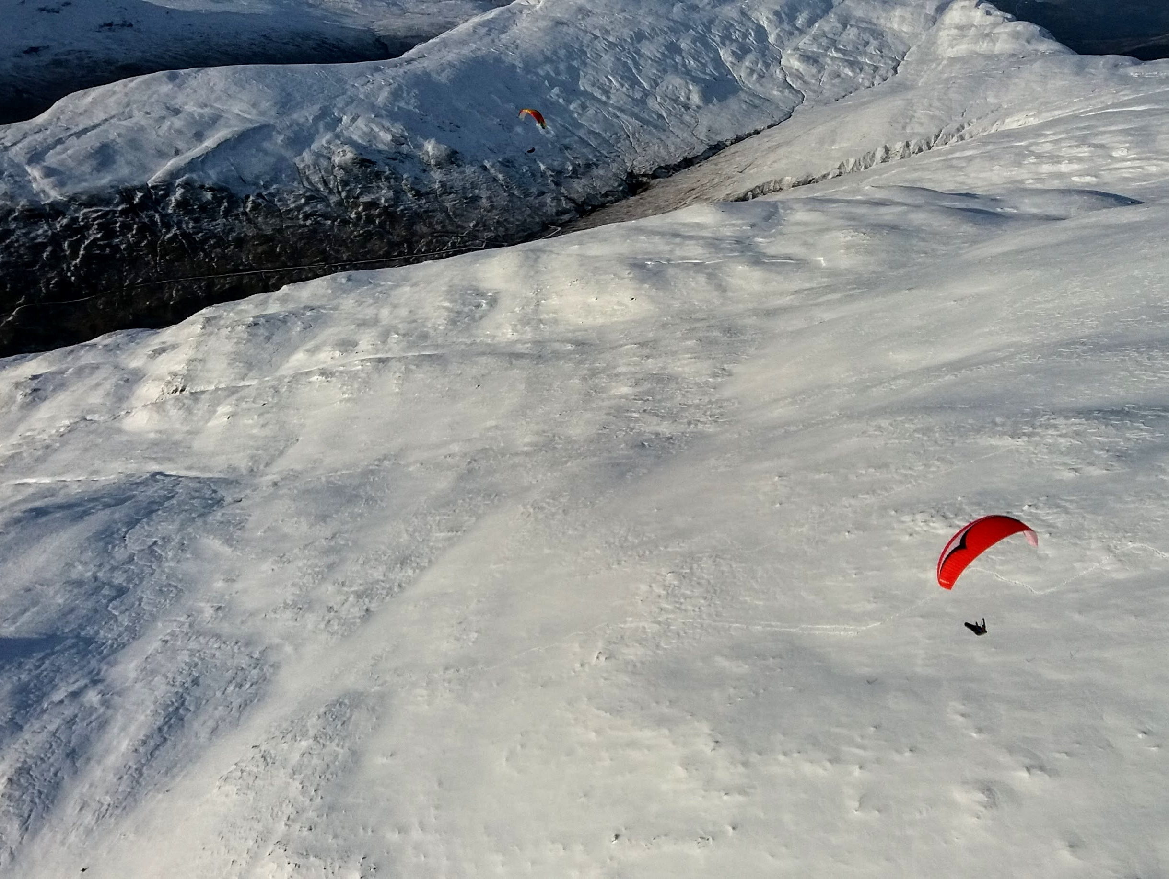
Winter weather
Przemek Marek
LLSC club night, Dec 2018

Slide 2
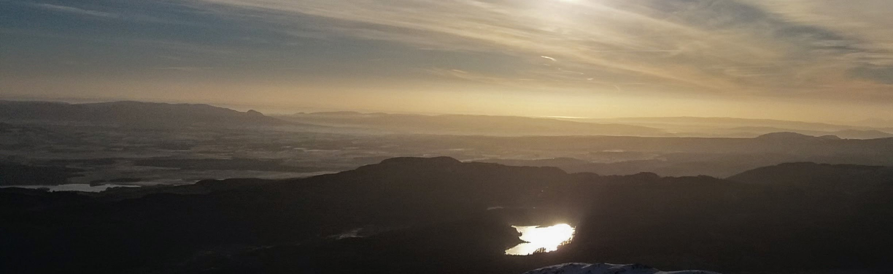
Coming up:
What’s different about winter?
Weather forecasting for a hike and fly
What to watch out for in big hills
Example SkewT
Final thoughts

Slide 3
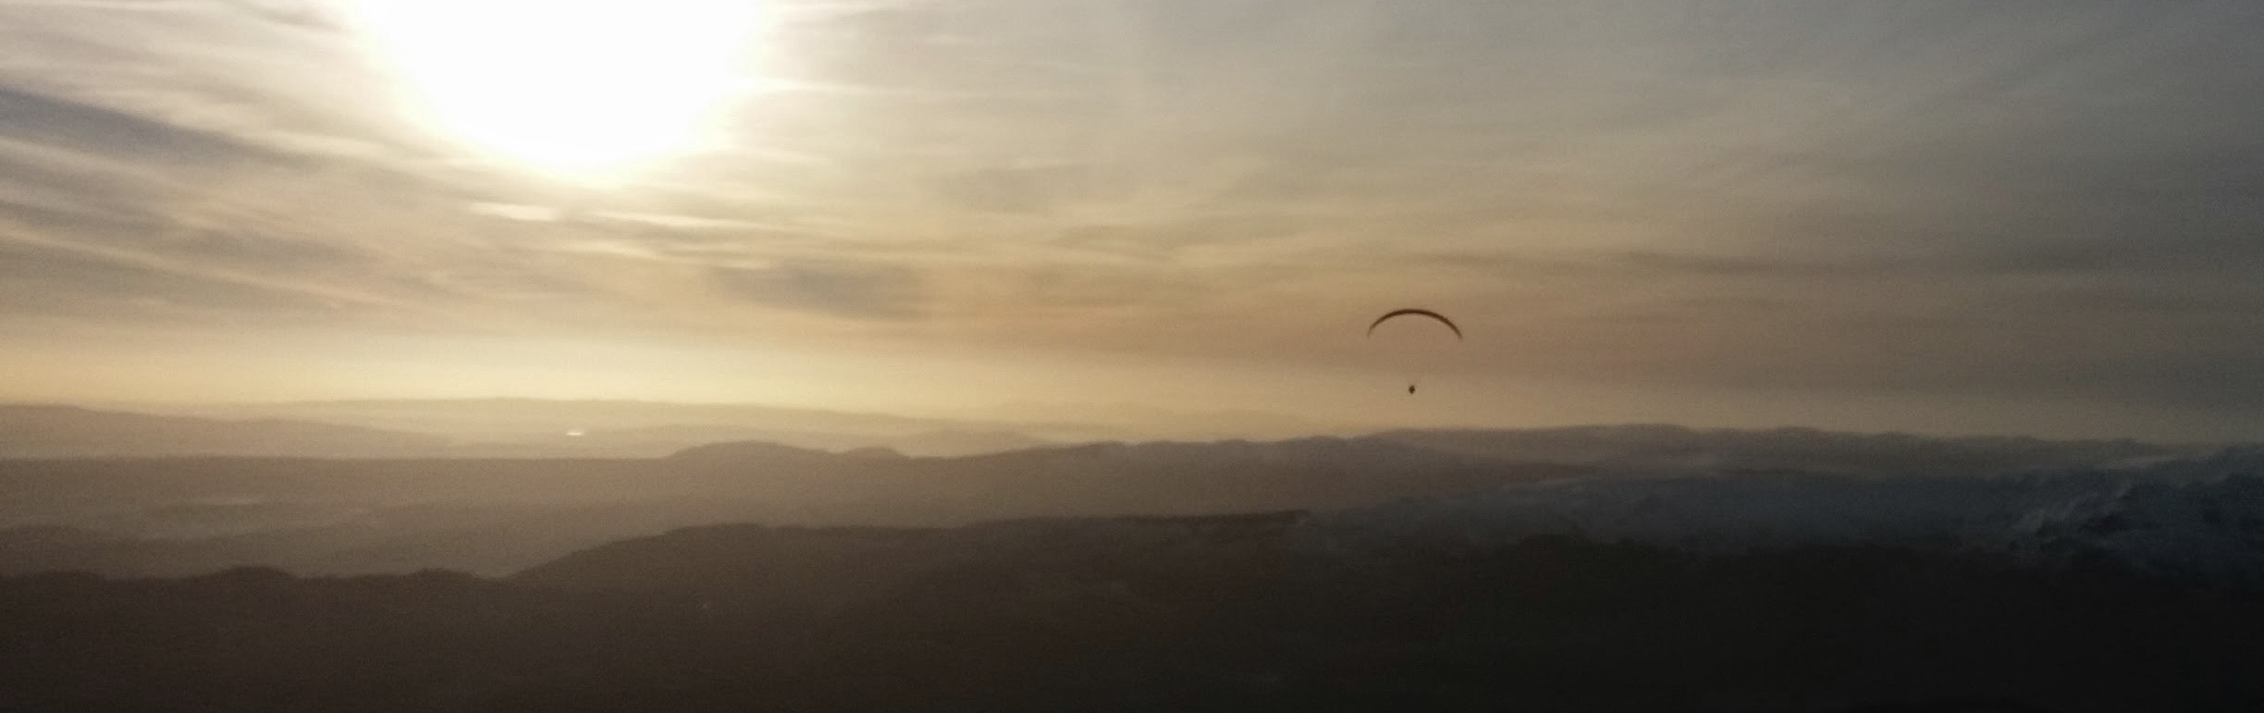
Why is winter “different”?
The sun is lower above the horizon
There is less heat coming in
Hence more stability in the atmosphere

Slide 4
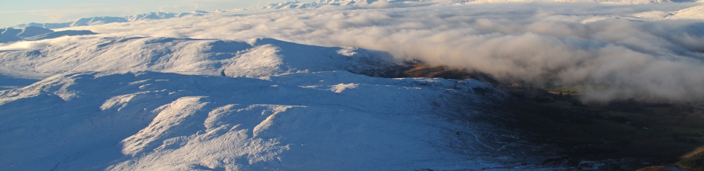
Which means...?
Stronger wind gradients
Lee side rotors reaching further downwind
Seriously strong capping inversions
Very “layered” air
  →Strong shear layers
  →Air flowing in unusual ways

Slide 5
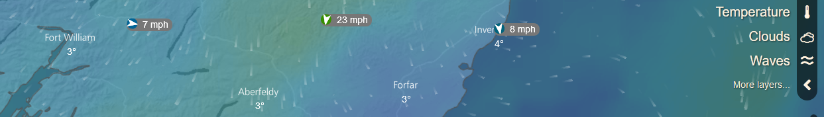
Weather forecasting in winter
(is not black magic if you know what to look for)
  Don’t look at XCWeather
  Check more height levels – both speed and direction
  Check more forecasts – do they agree?
  Check MWIS – does it tally up with our other sources?
  Check UKMO at hilltops – ditto.
  Know your SkewT for the day!
  Also: be sensible with snow: avalanches, hiking gear, sunrise/sunset times

Slide 6
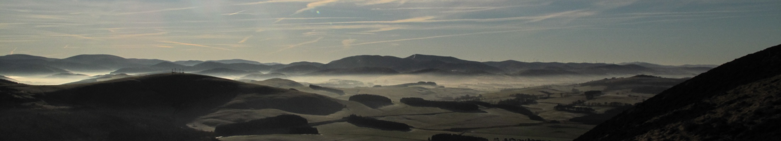
What do watch out for
  All the usual things, but often “turned to 11”:
  Larger lee sides
  Stronger turbulence in shear layers
  Wind direction can change significantly across the face
  Gullies can suck more
  Increased “compression”, especially on stable days
  Valleys with trapped cold air
  Hike and fly often involves new sites, so take a moment to ponder over what may be going on around.

Slide 7
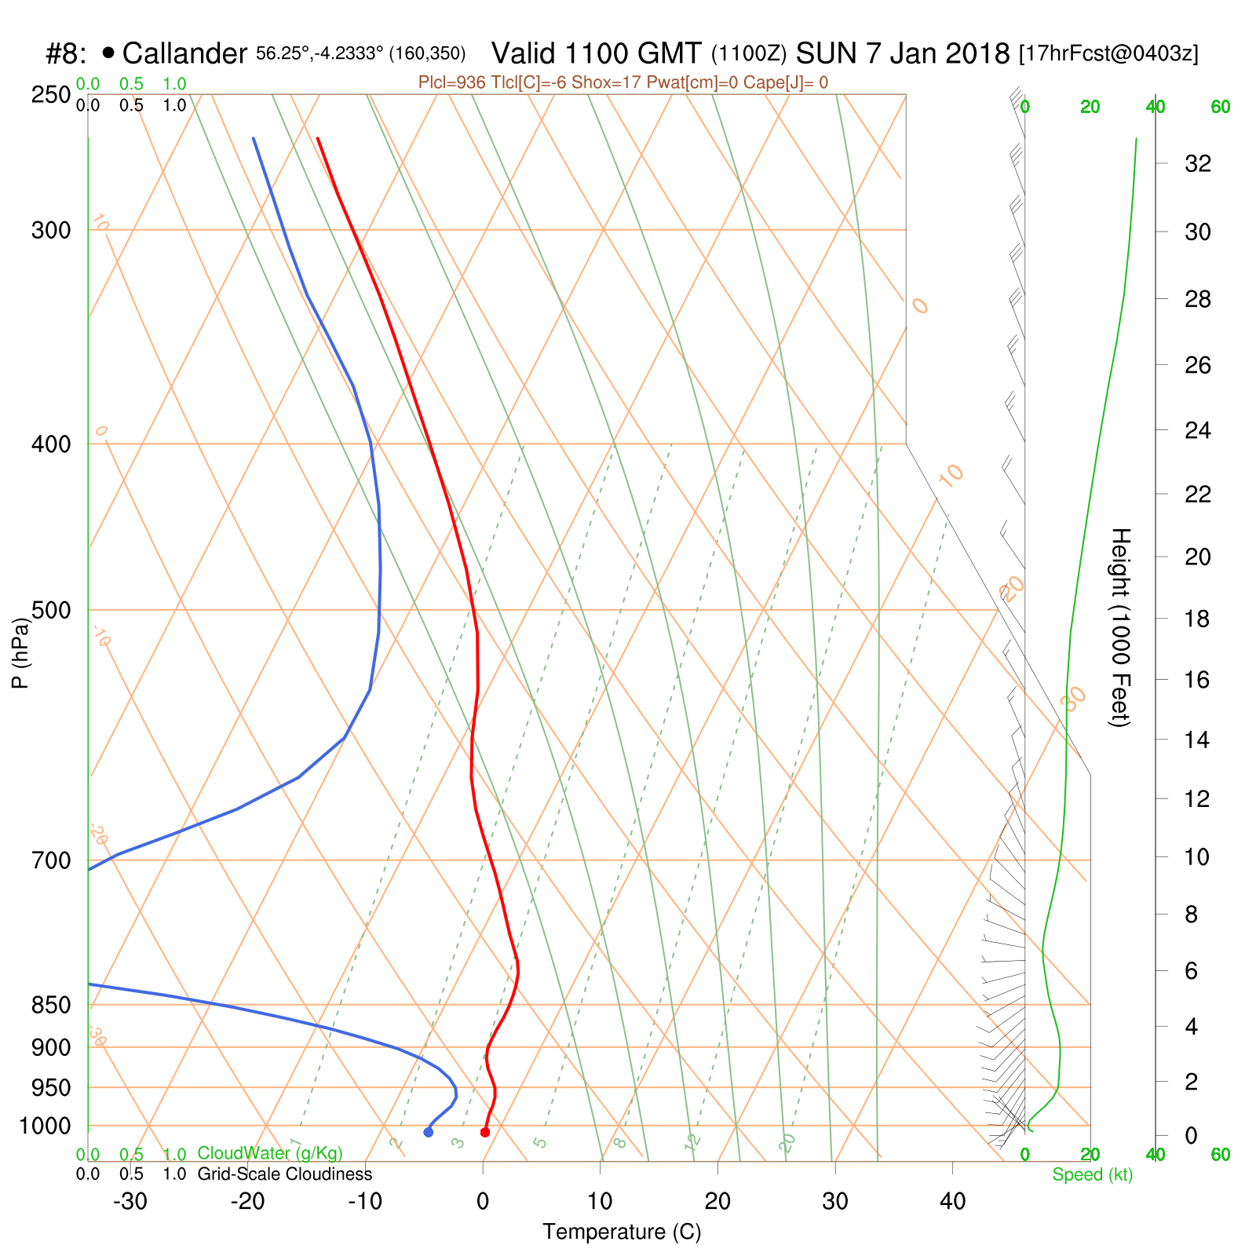
SkewT from Ben Ledi day

Slide 8

SkewT from Ben Ledi day

Slide 9
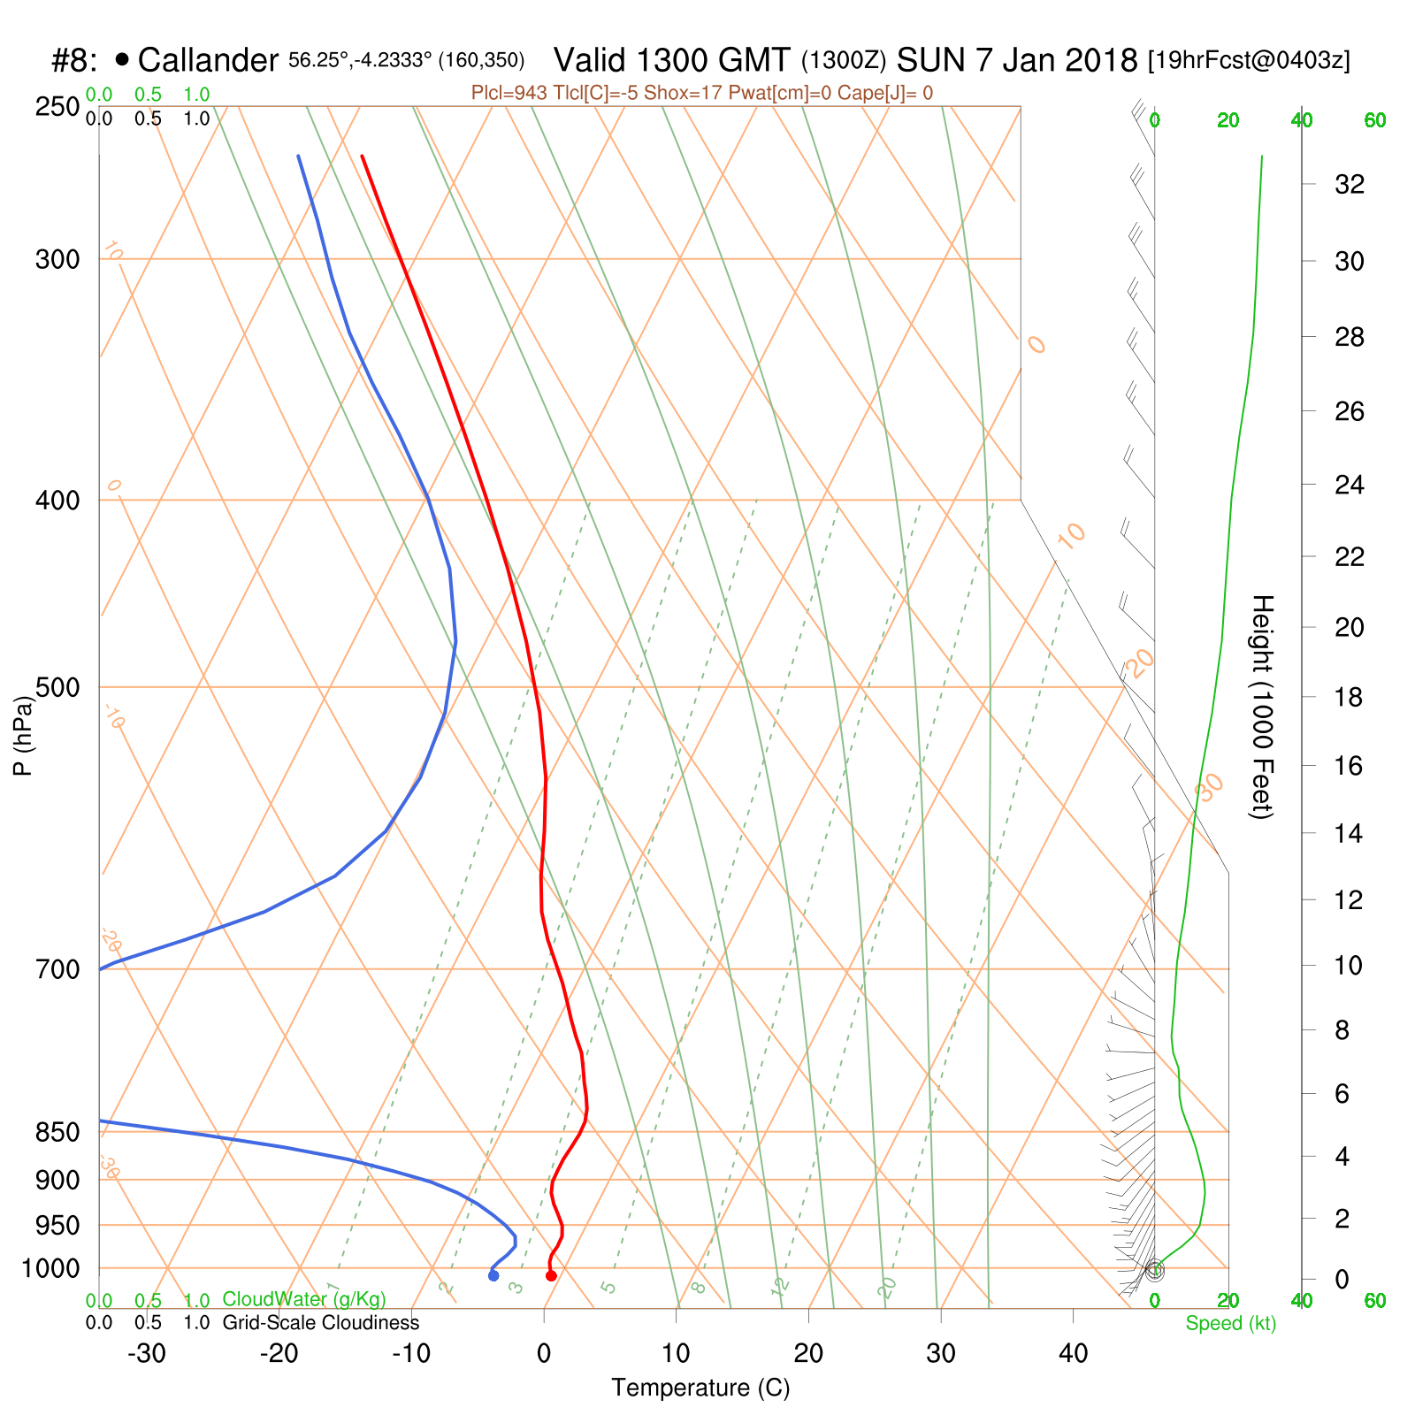
SkewT from Ben Ledi day

Slide 10

SkewT from Ben Ledi day

Slide 11
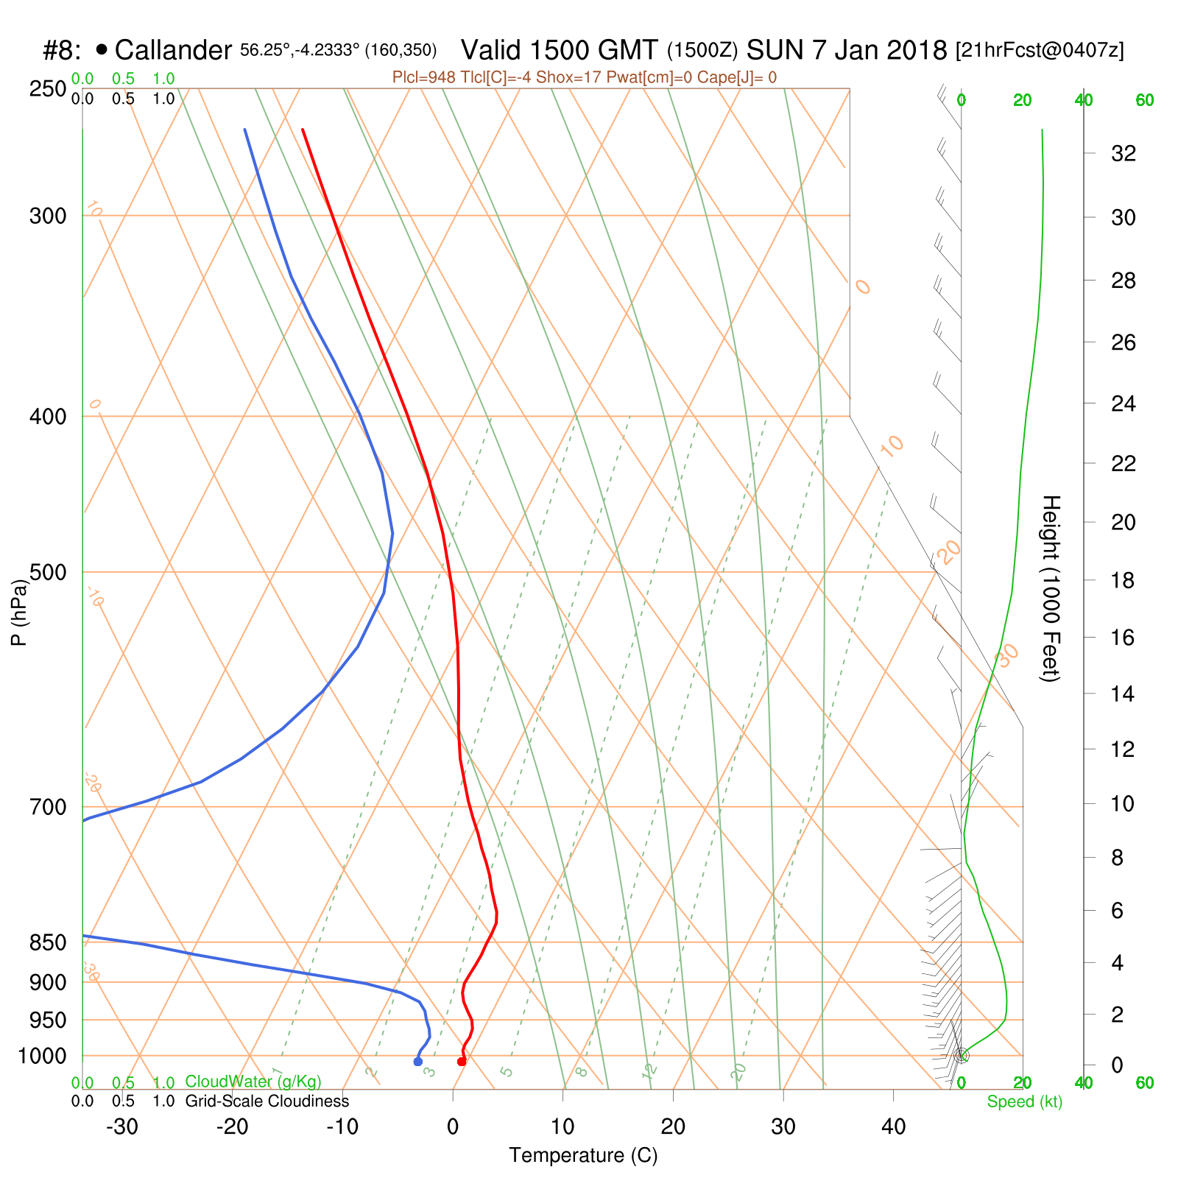
SkewT from Ben Ledi day

Slide 12
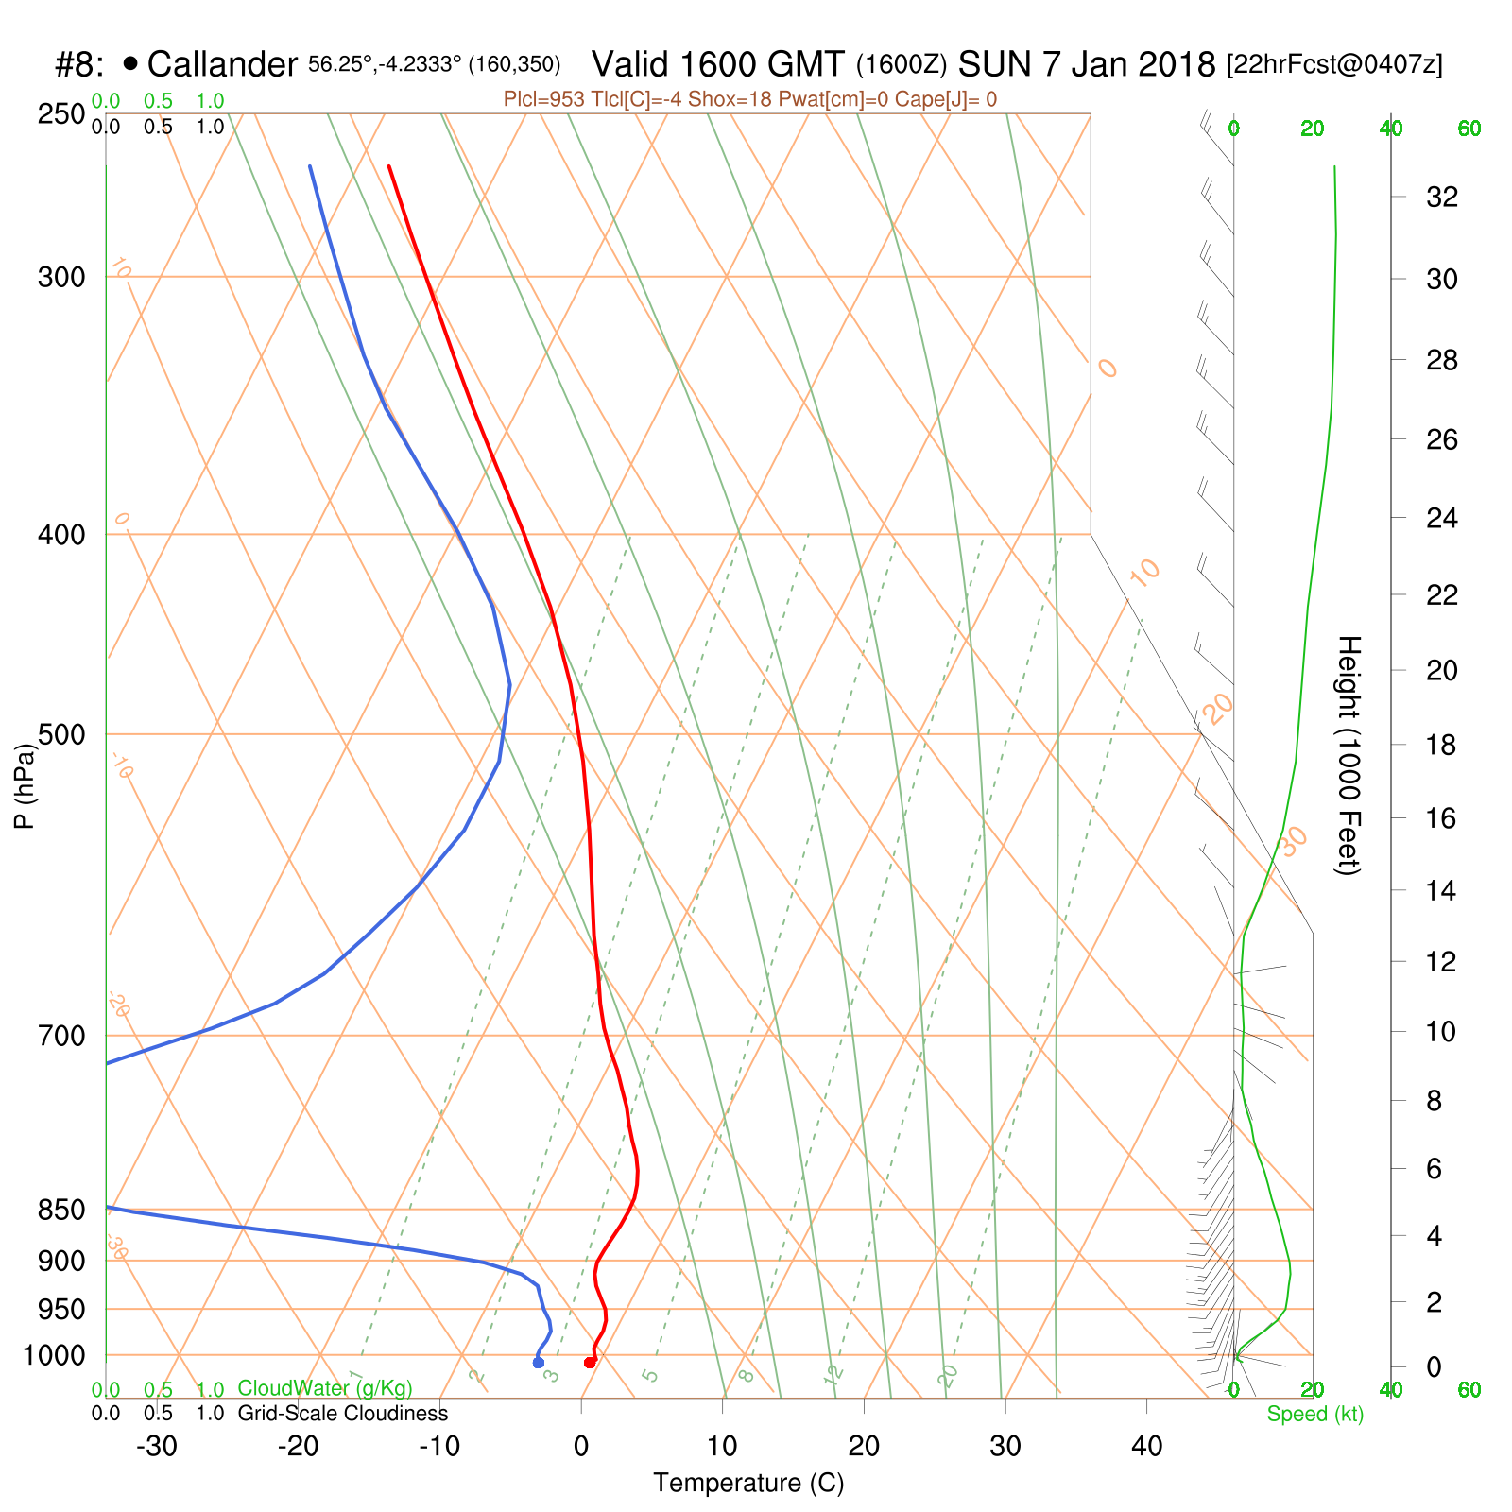
SkewT from Ben Ledi day

Slide 13
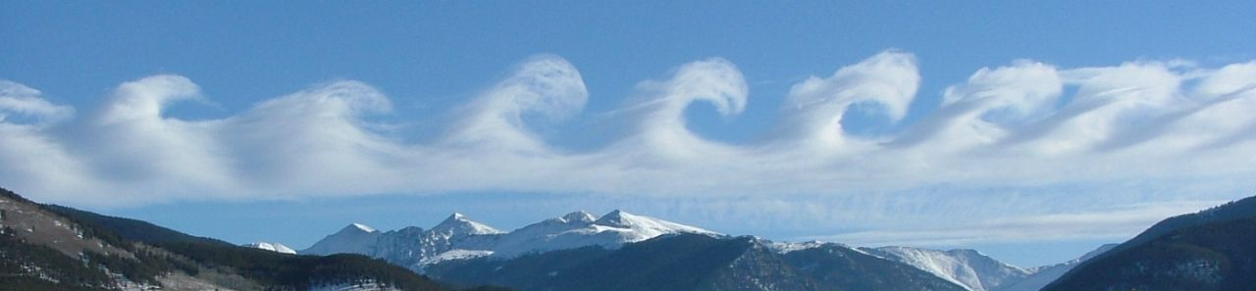
A word of warning
  Winter flying can be great, but there are more unknown unknowns out there:
  We are keen to get out
  We are less used to winter air flow patterns
  Forecasts tend to be less predictable
  Experienced pilots get caught out: https://goo.gl/R1PT4r

Slide 14
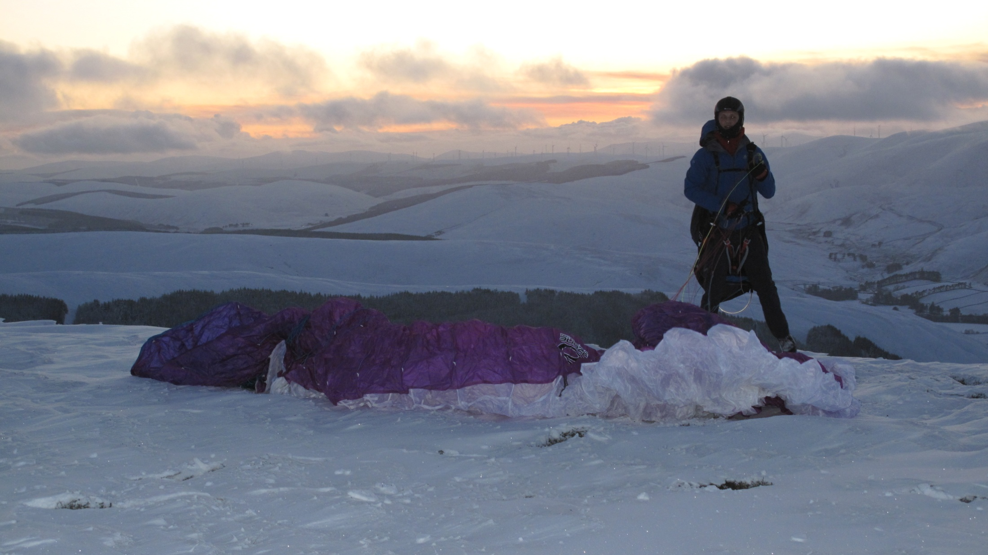
Have fun and stay safe

